Slide 1
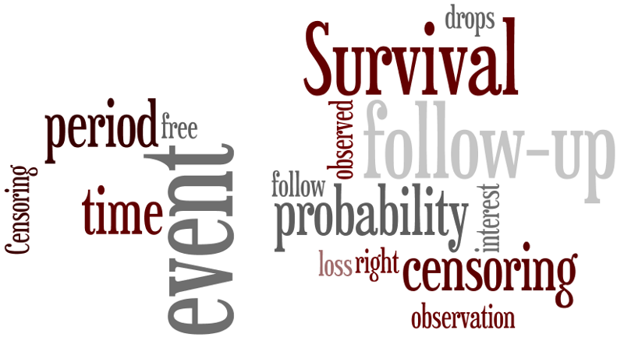

BST 210 Applied Regression Analysis
↩
↩

Slide 2
Lecture 22 Plan for Today
Notes:
- Group Projects (extension to 12/5; HW 9 still due 12/10; pick groups)
- Depository of readings under Discussions menu
- Framework for analysis re-debuted! (end of class)
Introduction to Survival Analysis:
A new outcome variable in town: Time!
Where have we seen a similar model?
Survival data: definition, notation and censoring
Kaplan-Meier estimate of survivor curve

Slide 3
Motivation
Methods discussed previously have facilitated assessing events and time in the following ways:
(Linear)
- how events relate to potential time factor (i.e. age, minutes)
(Logistic)
- whether event occurred or not (yes/no)
- potentially adjusting for time factor (i.e. age, minutes, year)
(Poisson)
- how many events occurred (count)
- over specified interval of time (i.e. 1 min, 24 hrs, 1 year)
Next…Survival
- a slightly different take on events and time!

Slide 4
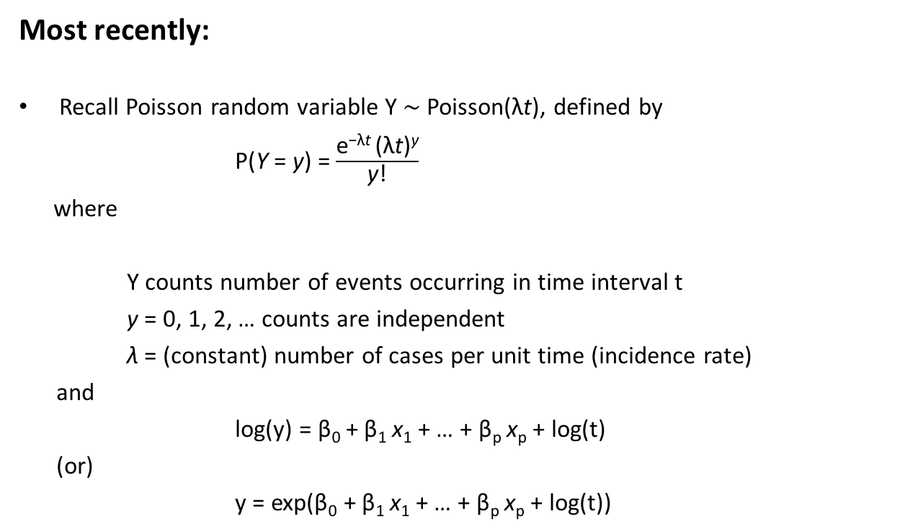
Motivation
Most recently:
Recall Poisson random variable Y $∼$Poisson($\text{λ}\text{t}$), defined by
P(Y = y) = $\frac{\text{e}\text{−}\text{λ}\text{t} \text{(}\text{λ}\text{t}\text{)}\text{y}}{\text{y}\text{!}}$
where
Y counts number of events occurring in time interval t
y = 0, 1, 2, … counts are independent
λ = (constant) number of cases per unit time (incidence rate)
and
log(y) = β₀ + β₁ x₁ + … + β_{p} x_{p} + log(t)
(or)
y = exp(β₀ + β₁ x₁ + … + β_{p} x_{p} + log(t))

Slide 5
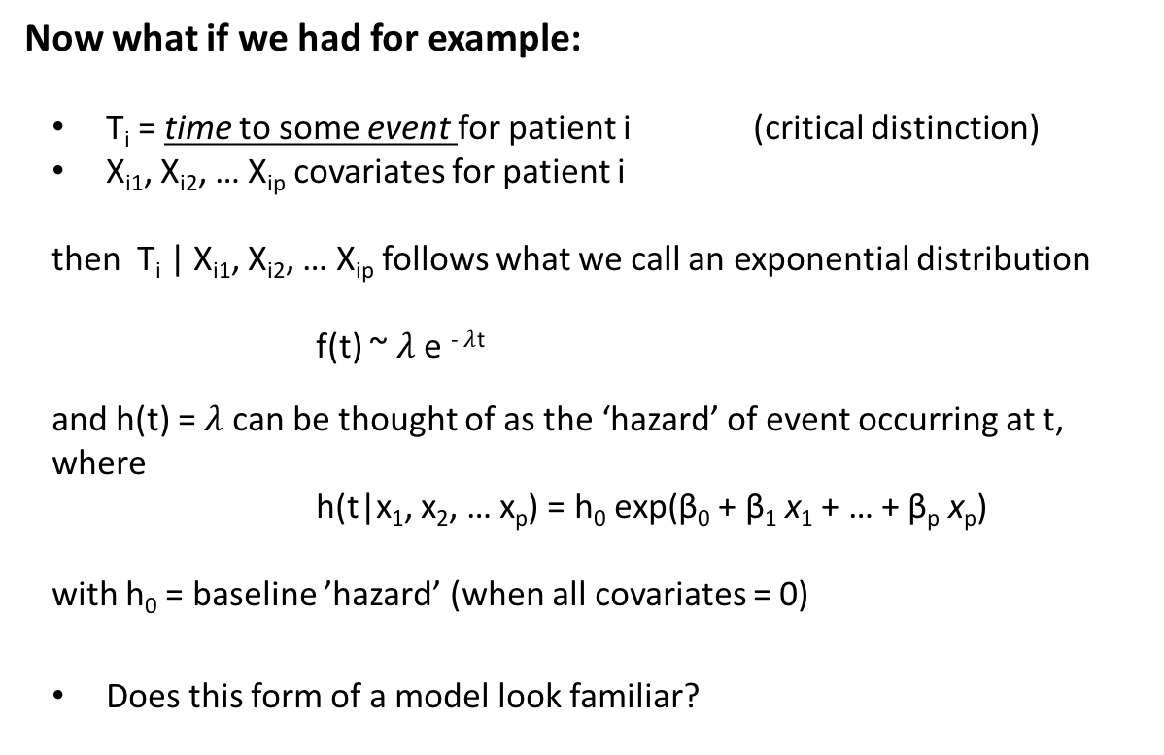
Motivation
Now what if we had for example:
T_{i} = time to some event for patient i (critical distinction)
X_{i1}, X_{i2}, … X_{ip} covariates for patient i
then T_{i} | X_{i1}, X_{i2}, … X_{ip} follows what we call an exponential distribution
f(t) ~ $λ$ e ⁻ $λ$^{t}
and h(t) = $λ$ can be thought of as the ‘hazard’ of event occurring at t,
where
h(t|x₁, x₂, … x_{p}) = h₀ $\text{ex}\text{p}\text{(}$β₀ + β₁ x₁ + … + β_{p} x_{p})
with h₀ = baseline ’hazard’ (when all covariates = 0)
Does this form of a model look familiar?

Slide 6
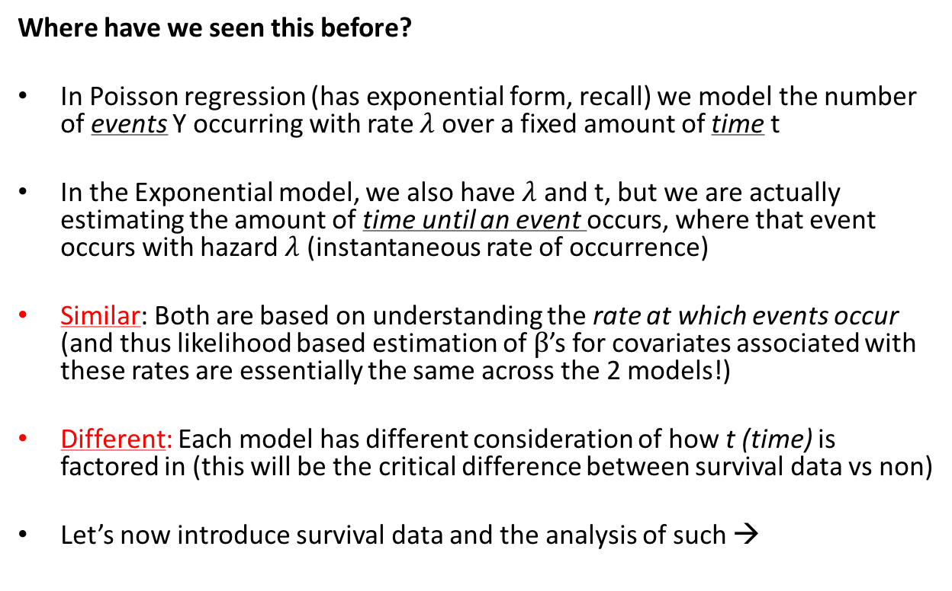
Motivation
Where have we seen this before?
In Poisson regression (has exponential form, recall) we model the number of events Y occurring with rate $λ$ over a fixed amount of time t
In the Exponential model, we also have $λ$ and t, but we are actually estimating the amount of time until an event occurs, where that event occurs with hazard $λ$ (instantaneous rate of occurrence)
Similar: Both are based on understanding the rate at which events occur (and thus likelihood based estimation of $β$’s for covariates associated with these rates are essentially the same across the 2 models!)
Different: Each model has different consideration of how t (time) is factored in (this will be the critical difference between survival data vs non)
Let’s now introduce survival data and the analysis of such →

Slide 7
Survival Data: It’s just a matter of ‘time’
In some studies, the response variable of interest is the length of time between an initial observation and the occurrence of a subsequent event
The event is often called a failure
The time from the initial observation until failure is called the survival time
Examples: Time from birth until death, time from start of treatment until serious adverse event, time from randomization to relapse or death, time from entry in a cohort study until myocardial infarction, time between live births, time until marriage, duration of geographic stay, etc.
Do you think distributions of survival times would tend to be skewed or not?

Slide 8
Survival Data
The analysis of incidence rates (e.g., Poisson regression) does not allow event rates to vary over time, after controlling for covariates (though breaking up of time periods for a subject can allow this)
The analysis of proportions (e.g., logistic regression) only considers whether an event occurs or does not occur
Survival analysis
- uses the time from the starting point to the occurrence of the event
- can allow the incidence rate to vary over time

Slide 9
Goals of Survival Analysis
Same themes as previous linear modeling…
To estimate the distribution of survival times for a population
To test the equality of survival distributions (e.g., treated vs. control group, smokers vs. nonsmokers)
To estimate and control for the effects of other covariates when investigating the relationship between a predictor variable and survival time
To assess model fit

Slide 10
Functions defining time T
There are essentially 4 related functions, all which help to define our survival (or failure) times T.
Let’s let random variable T represent the time from a start point to an event of interest (e.g., time from start of treatment to serious adverse event, time from disease remission to recurrence)
By definition, T must be ≥ 0
The survival function S(t) is then defined as:
S(t) = P(T > t)
S(t) is the proportion of individuals who are event-free at
time t, or the probability of not having the event until time t.

Slide 11
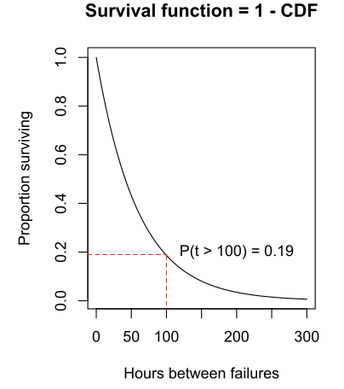
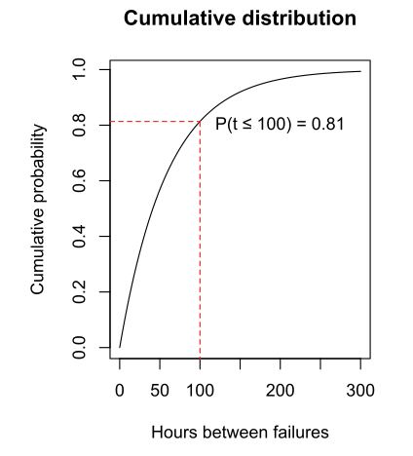
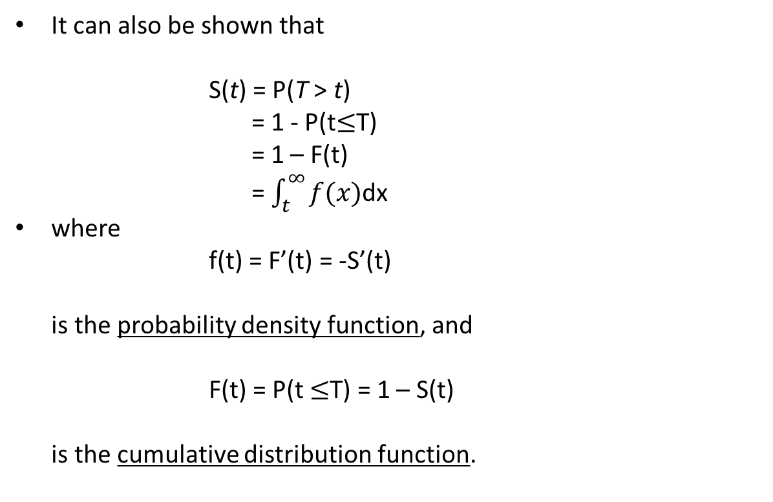
Functions defining time T
It can also be shown that
S(t) = P(T > t)
= 1 - P(t$≤$T)
= 1 – F(t)
= $\int_{t}^{∞}{f(x)}$dx
where
f(t) = F’(t) = -S’(t)
is the probability density function, and
F(t) = P(t $≤$T) = 1 – S(t)
is the cumulative distribution function.

Slide 12
Survival Function
Note that by definition,
0 ≤ S(t) ≤ 1 for each t ≥ 0
S(0) = 1
If t₂ ≥ t₁, then S(t₂) ≤ S(t₁), i.e., survival functions are non-increasing over time
The graph of a survival function S(t) versus time t is called a survival curve

Slide 13
Survival Curve

Slide 14
Survival Data
As we previously noted, distributions of survival times are frequently skewed to the right
Thus, mean survival time is usually not a good summary measure; the mean is pulled up toward the outlying values (and there may be censored values, making estimation of the mean difficult)
Instead, estimation of percentiles of the survival distribution is often preferable

Slide 15
Example: Chemotherapy for Leukemia
Let’s get a feel for what survival data actually looks like…
A pilot study was conducted among leukemia patients currently in remission
Leukemia patients were randomized to two groups:
(a) maintenance chemotherapy group
(b) control group (no chemotherapy)
Day of randomization was the start point of the study

Slide 16
Example: Chemotherapy for Leukemia
What do you think would be the goal of such a study?
The goal of the study was to compare the survival experience of the two treatment groups
Survival time is defined as time of randomization to time to relapse of leukemia
The endpoint is not just whether or not remission was maintained (e.g., binary), but for how long it was maintained (e.g., time to event)

Slide 17
Example: Chemotherapy for Leukemia
There were 11 patients randomized to the maintenance chemotherapy group, and 12 patients randomized to the control group
Time to relapse was measured for each subject
These times can also be thought of as length of complete remission (in weeks)

Slide 18
Example: Chemotherapy for Leukemia
‘Times to relapse’ in weeks for this study are:
Maintenance chemotherapy group (n = 11)
9, 13, 13+, 18, 23, 28+, 31, 34, 45+, 48, 161+
Control group (n = 12)
5, 5, 8, 8, 12, 16+, 23, 27, 30, 33, 43, 45
This is all cool…but what do the + signs represent?

Slide 19
Caveat with Survival Data: Censoring
This brings us to perhaps the most defining characteristic of survival data…we call it censoring (basically a missing data problem)
Since most studies occur over a finite time period, the event of interest may not have occurred for some subjects during the study period
All that is known is that the time to an event T is greater than the period of follow-up C, where C is called the censoring time
For subjects who have an event during the study period, we have the actual event time T

Slide 20
Example: Chemotherapy for Leukemia
Recall the times in weeks for this example study are:
Maintenance chemotherapy group (n = 11)
9, 13, 13+, 18, 23, 28+, 31, 34, 45+, 48, 161+
Control group (n = 12)
5, 5, 8, 8, 12, 16+, 23, 27, 30, 33, 43, 45

Slide 21
Example: Chemotherapy for Leukemia
What do we see here…
Patient # 2 in the maintenance chemotherapy group had a remission time of 13 weeks, which indicates that he/she relapsed during the study at 13 weeks
Patient # 3 in the maintenance chemotherapy group has a remission time of 13+, which means that the patient remained in remission for 13 weeks, did not have an event (i.e., relapse of leukemia), and was then censored at that time point
What does that mean, and how does censoring work?

Slide 22
Causes of Censoring
We could see no event by the end of the study (study closed)
Withdrawn from the study prior to its end (i.e., loss to follow-up), due to either
- lack of interest of the participant, or
- an adverse event which presented a medical
contraindication for continuing with the study
Death from another cause (e.g., death due to cancer in a study where the endpoint is myocardial infarction)

Slide 23
Effects of Censoring
Standard statistical methods could be used if all event times T were observed (continuous measurements)
…although the distribution of event times would most likely be skewed (meaning we might apply nonparametric methods or need transformations of the data, e.g., log(T), sqrt(T))
However, the presence of censoring makes this impossible, since some event times are unknown

Slide 24
Types of Censoring
So how does censoring tend to present itself?
(a) Right censoring
(b) Left censoring
(c) Interval censoring

Slide 25
Right Censoring
We know that the event time T is greater than the censoring time C
This is the most common form of censoring
For example, a subject enrolled in a clinical trial might be followed until the end of the trial without having an event
Loss to follow-up before an event occurs is another example of right censoring

Slide 26
Left Censoring
We know that the event time T is smaller than a specific time C (i.e., T < C)
For example, for the condition retinitis pigmentosa (RP), an important endpoint is time to legal blindness, defined as a visual acuity of 20/200 or worse, or a visual field of < 20º in both eyes
A patient seen at an RP clinic and enrolled in a study of adults at age 18 years may already have reached the endpoint of legal blindness
In this case, we would only know that T < 18

Slide 27
Interval Censoring
This type of censoring occurs when we know that the event occurred within an interval, but do not know the exact time of the event
For example, a subject comes to an RP clinic at age 20 and is not legally blind, but comes back at age 30 and is legally blind
In this case, 20 < T < 30

Slide 28
Effects of Censoring on Inference
To make valid comparisons of distributions of survival times between groups, we need to assume that the censoring time (C) is independent of the survival time (T)
(should ring familiar with topic of missing data)
This assumption implies that:
P(C|T = t) = P(C) for all t
This is called noninformative censoring

Slide 29
Effects of Censoring on Inference
An example of when the noninformative censoring assumption is valid is in the case of administrative censoring
A study is terminated at a fixed date before an event has occurred
T is unknown, but C is equal to the study termination date minus the enrollment date

Slide 30
Effects of Censoring on Inference
The assumption of noninformative censoring is not valid if subjects who are at higher risk for an endpoint (i.e., T is short) tend to also be at higher risk for an adverse event and subsequent loss-to-follow-up (i.e., C is also short)
Another example would be a smoking cessation study, where the endpoint is time to relapse
Subjects are randomized to receive either nicotine gum or placebo gum

Slide 31
Effects of Censoring on Inference
Subjects who stop responding to phone calls or emails at 2 months (C is short) might be more likely to relapse subsequently (T is short) than subjects who do respond and remain in the study (C is long)
The assumption of independence of C and T is usually untestable, since we do not completely observe the (T, C) pair for all subjects

Slide 32
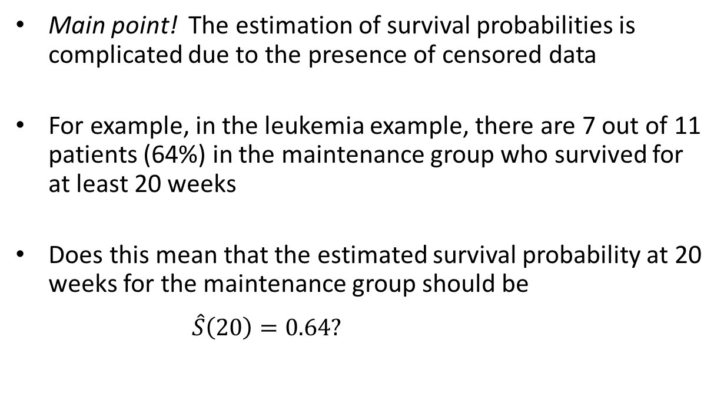
Effects of Censoring on Inference
Main point! The estimation of survival probabilities is complicated due to the presence of censored data
For example, in the leukemia example, there are 7 out of 11 patients (64%) in the maintenance group who survived for at least 20 weeks
Does this mean that the estimated survival probability at 20 weeks for the maintenance group should be
$\hat{S}\left(20\right)=0.64?$

Slide 33
Example: Chemotherapy for Leukemia
Recall the times in weeks for this example study are:
Maintenance chemotherapy group (n = 11)
9, 13, 13+, 18, 23, 28+, 31, 34, 45+, 48, 161+
Control group (n = 12)
5, 5, 8, 8, 12, 16+, 23, 27, 30, 33, 43, 45

Slide 34
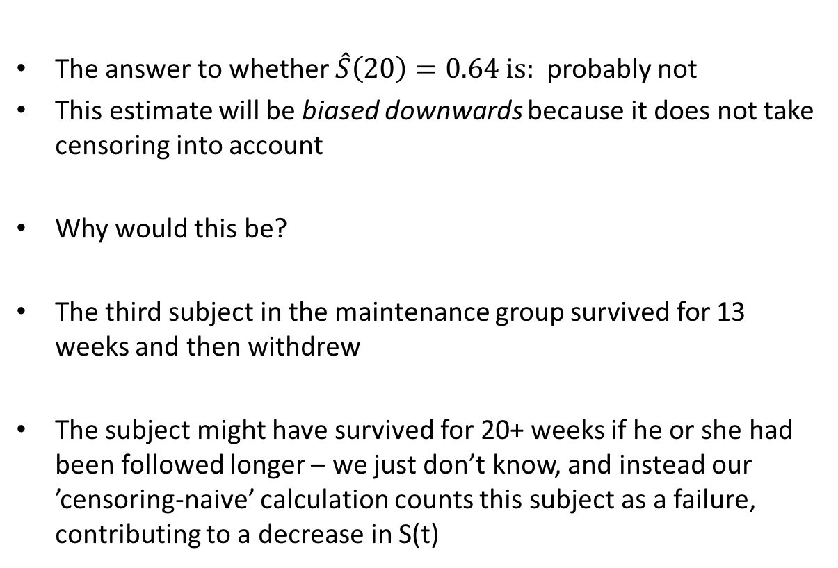
Effects of Censoring on Inference
The answer to whether $\hat{S}\left(20\right)=0.64 is:$probably not
This estimate will be biased downwards because it does not take censoring into account
Why would this be?
The third subject in the maintenance group survived for 13 weeks and then withdrew
The subject might have survived for 20+ weeks if he or she had been followed longer – we just don’t know, and instead our ’censoring-naive’ calculation counts this subject as a failure, contributing to a decrease in S(t)

Slide 35
Options for Estimation and Inference
What options then, do we have for estimating survival curves and thus probabilities, in the presence of censored data?
A nonparametric method for estimating survival curves that takes censoring into account is called the Kaplan-Meier estimator or the product-limit estimator
No assumptions are made about the underlying distribution of survival times (ie nonparametric)
Drawback: cannot account for any covariate data
Let’s examine this approach →

Slide 36
Example: Chemotherapy for Leukemia
Let us first consider the maintenance group only, and (incorrectly) assume there is no censoring (remove the + signs)
Times to event in weeks are:
Maintenance chemotherapy group (n = 11)
9, 13, 13, 18, 23, 28, 31, 34, 45, 48, 161
Now we just need to define who is at risk, when -->

Slide 37
Define a Risk Set
We define a patient to be at risk for an event at time t if they have not experienced an event before time t and are not yet censored at time t
Thus, for the maintenance chemotherapy group (n=11), the risk set consists of
11 patients at 0 weeks, 11 patients at 1 week, ..., 11 patients at 9 weeks
10 patients at 10 weeks, ..., 10 patients at 13 weeks
8 patients at 14 weeks, ..., 8 patients at 18 weeks, etc.
(where recall that weeks = 9, 13, 13, 18, 23, 28, 31, 34, 45, 48, 161)

Slide 38
Product Limit Method
How then does the Kaplan-Meier estimation method work? Let…
t_{i} = distinct observed failure times (uncensored) in increasing order so that
t₁ < t₂ < t₃ < … < t_{m-1} < t_{m}
m = number of distinct failure times
n_{i} = number of subjects in the risk set at time t_{i}
d_{i} = number of failures (events) at time t_{i}

Slide 39
Product Limit Method
Let:

Slide 40
Kaplan-Meier Estimate
Then we have
S(0) = 1
Estimated survival decreases after each of the failure times
In order for subject i to have T_{i} > t_{k}, subject i needs to
(1) be at risk at time t₁ and have T_{i} > t₁,
(2) be at risk at time t₂ and have T_{i} > t₂,
…
(k) be at risk at time t_{k} and have T_{i} > t_{k}

Slide 41
Kaplan-Meier Estimate
The Kaplan-Meier Estimate S(t) simply multiplies these ’running’ conditional probabilities together up through each event time
Thus, using the multiplication rule of probability,

Slide 42
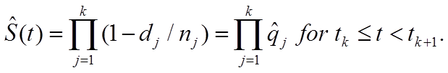
Kaplan-Meier Estimate
This can also be stated in terms of the survival function, as:
S(t_{i}) = P(T > t_{i})
= P(T > t₁) x P(T > t₂ | survived to t₁)
x P(T > t₃ | survived to t₂) x ...
x P(T > t_{i} | survived to t_{i-1})
In general, the K-M survival function is estimated as

Slide 43
Kaplan-Meier Estimate
Where specifically for a certain risk set:

Slide 44
Example: Chemotherapy and Leukemia (no censoring)
n_{j} t_{j} S(t_{j})
-------------------------------------------------------------------------
11 0 1
11 9 1 ̶ (1/11) = 10/11 = 0.909
10 13 (10/11) x (1 ̶ 2/10) = 8/11 = 0.727
8 18 (8/11) x (1 ̶ 1/8) = 7/11 = 0.636
7 23 (7/11) x (1 ̶ 1/7) = 6/11 = 0.545
6 28 (6/11) x (1 ̶ 1/6) = 5/11 = 0.455
5 31 (5/11) x (1 ̶ 1/5) = 4/11 = 0.364
4 34 (4/11) x (1 ̶ 1/4) = 3/11 = 0.273 etc.

Slide 45
Example: Chemotherapy for Leukemia
Now return the censored observations
Times to event in weeks are:
Maintenance chemotherapy group (n = 11)
9, 13, 13+, 18, 23, 28+, 31, 34, 45+, 48, 161+
Control group (n = 12)
5, 5, 8, 8, 12, 16+, 23, 27, 30, 33, 43, 45

Slide 46
Risk Set (censoring)
We still define a patient to be at risk for an event at time t if they have not experienced an event before time t and are not yet censored just before time t
A subject who is censored at time t is assumed to have had no event up to time t, and then gets censored (taken out of the risk set) just after time t

Slide 47
Risk Set
Therefore, the third patient in the maintenance group (coded as 13+) is in the risk set at 13 weeks, but is not followed beyond 13 weeks
Thus, for the maintenance chemotherapy group, the risk set consists of
11 patients at 0 weeks, 11 patients at 1 week, ..., 11 patients at 9 weeks
10 patients at 10 weeks, ..., 10 patients at 13 weeks
8 patients at 14 weeks, ..., 8 patients at 18 weeks, etc.

Slide 48
Example: Chemotherapy and Leukemia
For the maintenance group, t₁ = 9, t₂ = 13, t₃ = 18, etc.
Note that the subject who is censored at 13 weeks is assumed to survive longer than the subject who fails at 13 weeks

Slide 49
Example: Chemotherapy and Leukemia (with censoring)
n_{j} t_{j} S(t_{j})
---------------------------------------------------------------------
11 0 1
11 9 1 ̶ (1/11) = 10/11 = 0.909
10 13 (10/11) x (1 ̶ 1/10) = 9/11 = 0.818
8 18 (9/11) x (1 ̶ 1/8) = (9/11) (7/8) = 0.716
7 23 0.716 x (1 ̶ 1/7) = 0.614
5 31 0.614 x (1 ̶ 1/5) = 0.491
4 34 0.491 x (1 ̶ 1/4) = 0.368
2 48 0.368 x (1 ̶ 1/2) = 0.184 etc.

Slide 50
Estimating Survival Curves
The data set must have separate columns for:
the survival time (possibly censored)
the failure indicator
= 1 if a subject fails
= 0 if a subject is censored
(c) a group indicator variable (if there is one)
Or (b’) the censoring indicator (= 1 if a subject is censored, = 0 if a subject fails)

Slide 51
Estimated Survival Curve

Slide 52
Estimated Survival Curves (two groups)

Slide 53
Estimated Survival Curves (two groups)

Slide 54
Survival Function
The survival function allows us to estimate the probability of survival beyond a specified time point t
In the chemotherapy maintenance group, the estimated probability of surviving at least 23 weeks is 0.614
The estimated probability of surviving at least 20 weeks is 0.716
But, what is a confidence interval or standard error estimate for these quantities?

Slide 55
Interval Estimation for Survival Probabilities
The most popular method for obtaining interval estimates for survival probabilities is to use Greenwood’s formula
Although survival probabilities must lie between 0 and 1, this is different than the calculation of confidence intervals for binomial proportions -- the denominator changes over time as subjects drop out of the risk set
Greenwood’s method is based on calculating a confidence interval for log[S(t)] rather than S(t) itself, since the natural log of the survival function is more closely normally distributed than the survival function itself
We then exponentiate the lower and upper bounds to get a confidence interval for S(t)

Slide 56
Greenwood’s Formula
Using the delta method, it can be shown that:

Slide 57
Confidence Interval for S(t_{k})
In the example, there are 3 survival times in the maintenance group that are ≤ 20 weeks: 9, 13, and 18 weeks
The variance of log[S(t)] will be summed over these 3 time points

Slide 58
Confidence Interval for S(t_{k})

Slide 59
Confidence Interval for S(t_{k})

Slide 60
Confidence Interval for S(t_{k})
Since exp(x) can be > 1, it is possible that confidence intervals based on the natural log transformation will yield upper confidence limits for S(t) that are > 1, as seen in the previous example
An alternative approach is to use the complementary log-log transformation instead of the log transformation when constructing confidence intervals

Slide 61
Confidence Interval for S(t_{k})
The complementary log-log transformation is given by:
y(t) = log{ ̶ log[S(t)]}
The advantage of this transformation is that if we solve for S(t) as a function of y(t), we obtain:

Slide 62
Confidence Interval for S(t_{k})
The variance formula is more complicated than for the log transformation

Slide 63
Coming Up
Log Rank test to compare survival curves
Much more on survival analysis! – including the Cox proportional hazards model

Slide 64
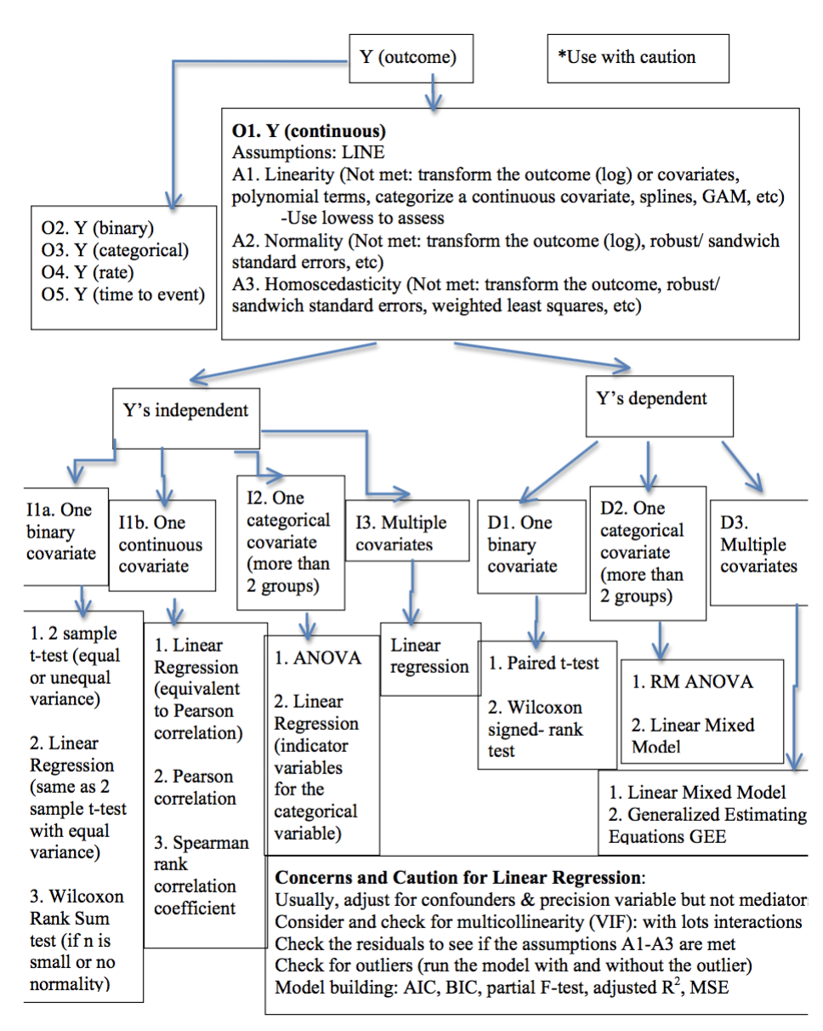

Slide 65
